Slide 1

Recurrent Neural Networks
Learning Objectives:
Define notation for building sequence models.
Describe the architecture of a basic RNN.
Identify the main components of an LSTM.
Implement backpropagation through time for a basic RNN and an LSTM.
Give examples of several types of RNN.
Build a character-level text generation model using an RNN.
Store text data for processing using an RNN.
Sample novel sequences in an RNN.

Slide 2
Recurrent Neural Networks
Learning Objectives:
Explain the vanishing/exploding gradient problem in RNNs.
Apply gradient clipping as a solution for exploding gradients.
Describe the architecture of a GRU.
Use a bidirectional RNN to take information from two points of a sequence.
Stack multiple RNNs on top of each other to create a deep RNN.
Use the flexible Functional API to create complex models.
Generate your own jazz music with deep learning.
Apply an LSTM to a music generation task.

Slide 3
Recurrent Neural Networks
1 Why sequence models?
2 Notation
3 Recurrent Neural Network Model
4 Backpropagation through time
5 Different types of RNNs
6 Language model and sequence generation
7 Sampling novel sequences
8 Vanishing gradients with RNNs
9 Gated Recurrent Unit (GRU)
10 LSTM (long short term memory) unit
11 Bidirectional RNN
12 Deep RNNs

Slide 4
Recurrent Neural Networks
Why sequence models?

Slide 5
Why sequence models?
Sequence models are useful for handling tasks involving sequential data, such as natural language processing, speech recognition, music generation, and more.
Traditional neural networks do not have the ability to capture temporal dependencies in data, but sequence models, such as recurrent neural networks (RNNs) and long short-term memory (LSTM) networks, can process input data sequentially while maintaining an internal state that allows them to retain information from previous inputs. This makes sequence models well-suited to handle tasks where context and temporal relationships are important.
Notes:
Sequence models are a type of deep learning model that have been particularly useful in speech recognition, natural language processing, and other areas.
The input and output in these applications are often sequence data. For example, in speech recognition, the input is an audio clip and the output is a sequence of words. Other examples of problems that can be addressed with sequence models include music generation, sentiment classification, DNA sequence analysis, machine translation, video activity recognition, and named entity recognition.
Sequence models are useful for handling tasks involving sequential data, such as natural language processing, speech recognition, music generation, and more. Traditional neural networks do not have the ability to capture temporal dependencies in data, but sequence models, such as recurrent neural networks (RNNs) and long short-term memory (LSTM) networks, can process input data sequentially while maintaining an internal state that allows them to retain information from previous inputs. This makes sequence models well-suited to handle tasks where context and temporal relationships are important.

Slide 6
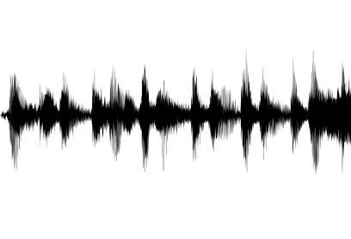





Examples of sequence data
“The quick brown fox jumped over the lazy dog.”
Speech recognition
Music generation
∅
“There is nothing to like in this movie.”
Sentiment classification
DNA sequence analysis
AGCCCCTGTGAGGAACTAG
AGCCCCTGTGAGGAACTAG
Machine translation
Voulez-vous chanter avec moi?
Do you want to sing with me?
Video activity recognition
Running
Name entity recognition
Yesterday, Harry Potter met Hermione Granger.
Yesterday, Harry Potter met Hermione Granger.

Slide 7
Recurrent Neural Networks
Notation

Slide 8
Notation
In sequence models, it's common to use notations to represent input and output sequences along with their indices.
X represents the input sequence of words.
Y represents the output sequence.
X^{<t>} represents a specific word at position t in the input sequence.
Y^{<t>} represents the corresponding label in the output sequence.
T_{x} denotes the length of the input sequence.
T_{y} denotes the length of the output sequence.

Slide 9
Movating Example
Let's consider an example sentence: "Harry Potter and Hermione Granger invented a new spell“. Let say you want a sequence model to automatically tell you where are the peoples names in this sentence. So, this is a problem called Named-entity recognition (NER).
X={"Harry", " Potter", "and", "Hermione", "Granger", "invented", “a“, “new“, “spell"}
T_{x} = 9 (the length of the input sequence)
Perform named-entity recognition where each word is classified as either a person's name (1) or other (0).
Y = {1, 1, 0, 1, 1, 0, 0, 0, 0}
T_{y} = 9 (the length of the output sequence)
Using the provided notation:
X = (X^{<1>}, X^{<2>}, X^{<3>} , X^{<4>},X^{<5>}, X^{<6>} , X^{<7>},X^{<8>}, X^{<9>})
Y = (Y^{<1>}, Y^{<2>}, Y^{<3>} , Y^{<4>},Y^{<5>}, Y^{<6>} , Y^{<7>},Y^{<8>}, Y^{<9>})

Slide 10
Movating Example
For a specific word at position t:
X^{<t>} represents a word in the input sequence, e.g., X^{<3>} = "and".
Y^{<t>} represents the corresponding label in the output sequence, e.g., Y^{<4>} = 1.
So, in this example:
X^{<3>} = “and"
X^{<4>} = "Hermione "
Y^{<3>} = 0
Y^{<4>} = 1

Slide 11
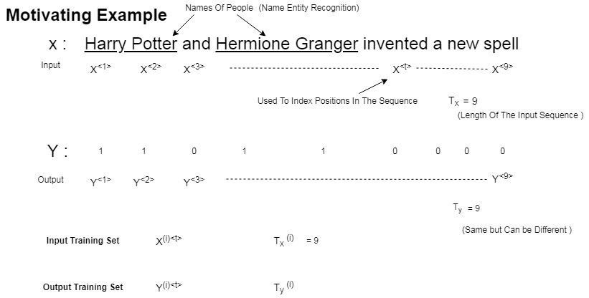

Slide 12
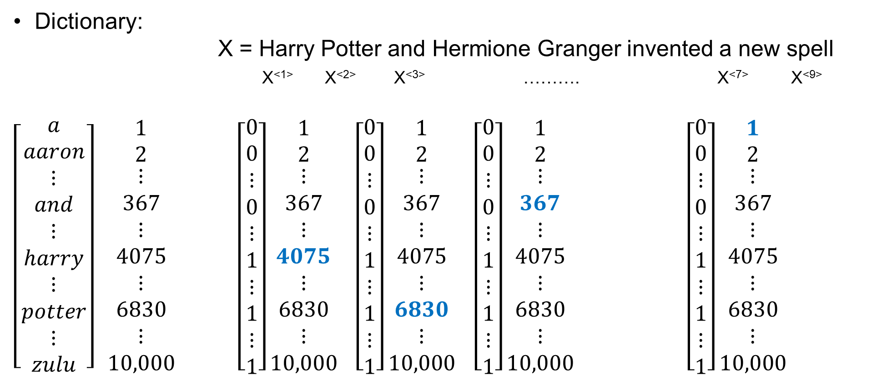
Notation
Dictionary:
X = Harry Potter and Hermione Granger invented a new spell
X^{<1>} X^{<2>} X^{<3>} ………. X^{<7>} X^{<9>}
$\left[\begin{aligned}a \\ aaron \\ ⋮ \\ and \\ ⋮ \\ harry \\ ⋮ \\ potter \\ ⋮ \\ zulu\end{aligned}\right]$ $\begin{matrix}1 \\ 2 \\ \begin{aligned}⋮ \\ 367 \\ ⋮ \\ 4075 \\ ⋮ \\ 6830 \\ ⋮ \\ 10,000\end{aligned}\end{matrix}$ $\left[\begin{aligned}0 \\ 0 \\ ⋮ \\ 0 \\ ⋮ \\ 1 \\ ⋮ \\ 1 \\ ⋮ \\ 1\end{aligned}\right]\begin{matrix}1 \\ 2 \\ \begin{aligned}⋮ \\ 367 \\ ⋮ \\ 4075 \\ ⋮ \\ 6830 \\ ⋮ \\ 10,000\end{aligned}\end{matrix}$ $\left[\begin{aligned}0 \\ 0 \\ ⋮ \\ 0 \\ ⋮ \\ 1 \\ ⋮ \\ 1 \\ ⋮ \\ 1\end{aligned}\right]\begin{matrix}1 \\ 2 \\ \begin{aligned}⋮ \\ 367 \\ ⋮ \\ 4075 \\ ⋮ \\ 6830 \\ ⋮ \\ 10,000\end{aligned}\end{matrix}$ $\left[\begin{aligned}0 \\ 0 \\ ⋮ \\ 0 \\ ⋮ \\ 1 \\ ⋮ \\ 1 \\ ⋮ \\ 1\end{aligned}\right]\begin{matrix}1 \\ 2 \\ \begin{aligned}⋮ \\ 367 \\ ⋮ \\ 4075 \\ ⋮ \\ 6830 \\ ⋮ \\ 10,000\end{aligned}\end{matrix}$ $\left[\begin{aligned}0 \\ 0 \\ ⋮ \\ 0 \\ ⋮ \\ 1 \\ ⋮ \\ 1 \\ ⋮ \\ 1\end{aligned}\right]\begin{matrix}1 \\ 2 \\ \begin{aligned}⋮ \\ 367 \\ ⋮ \\ 4075 \\ ⋮ \\ 6830 \\ ⋮ \\ 10,000\end{aligned}\end{matrix}$
Notes:
How we would represent individual words in a sentence?
- A dictionary of 10,000 words is used as an example, and one-hot representations are used to represent each word.
- The first step is to choose the vocabulary by finding the top occurring words in the training set or using online dictionaries.
- Then, each word is represented as a 10,000-dimensional vector, with exactly one 1 in the position corresponding to the word in the vocabulary and zeros everywhere else. For example, the word "Harry" would be represented by a vector with a 1 in position 4075, which is the position of "Harry" in the vocabulary. The goal is to learn a mapping from X to Y using a sequence model as a supervised learning problem.

Slide 13
Notation
What to do if an unknown word is encountered?
- In this case, a new token called "Unknown Word" or "UNK" is created to represent words not in the vocabulary.
Overall, the basic notation and vocabulary representation, which are used in sequence models, will be used to build recurrent neural networks in the next section.

Slide 14
Recurrent Neural Networks
Recurrent Neural Network Model

Slide 15
Recurrent Neural Network Model
Standard neural networks have limitations in handling varying input and output lengths and sharing learned features across text positions.
RNNs address this with a looped structure, passing activations from previous to current time steps.
Unidirectional RNNs use only past information, limiting some tasks. To overcome this, bidirectional RNNs are suggested.
Forward propagation involves computing each time step's output using previous activations and current input. Notation is simplified for complex models.
Backpropagation learns parameters by minimizing a loss function, detailed in a later section.
Notes:
The limitations of using a standard neural network for this task, namely the difference in input and output lengths and the inability to share learned features across different positions of the text.
The RNN architecture addresses these issues by using a looped structure that passes on the activation from the previous time step to the current time step. This allows the network to learn from previous inputs and share learned features across different positions of the text.
However, the unidirectional RNN only uses information earlier in the sequence to make a prediction, which can be limiting for certain tasks. To address this limitation, the speaker suggests using bi-directional RNNs in a later video.
The calculations involved in forward propagation in an RNN, where the output at each time step is computed using the activation from the previous time step and the current input. The notation was simplified by compressing the parameter matrices into one parameter matrix for ease of notation in more complex models.
Backpropagation is used to learn the parameters of the RNN by minimizing a loss function, which will be covered in a later section.

Slide 16
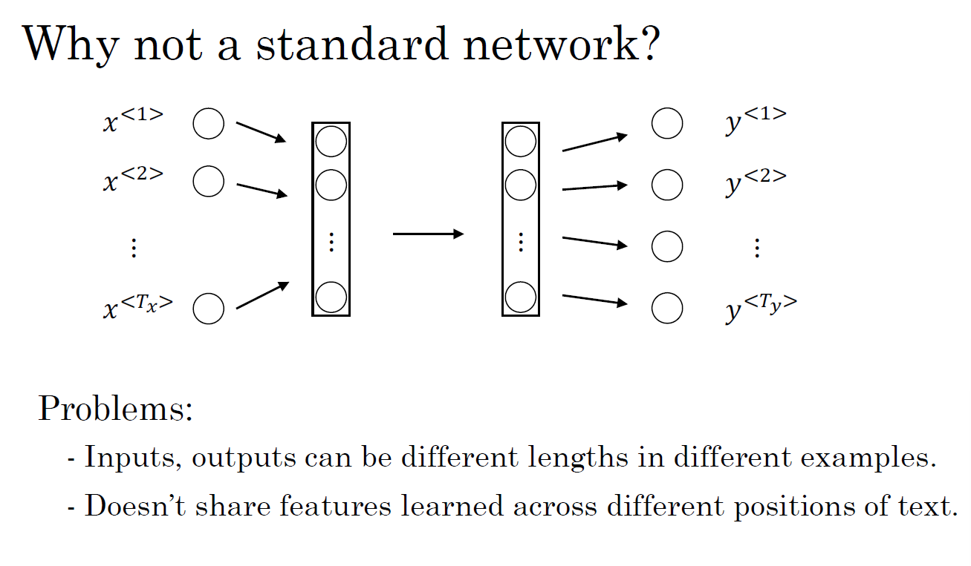

Slide 17
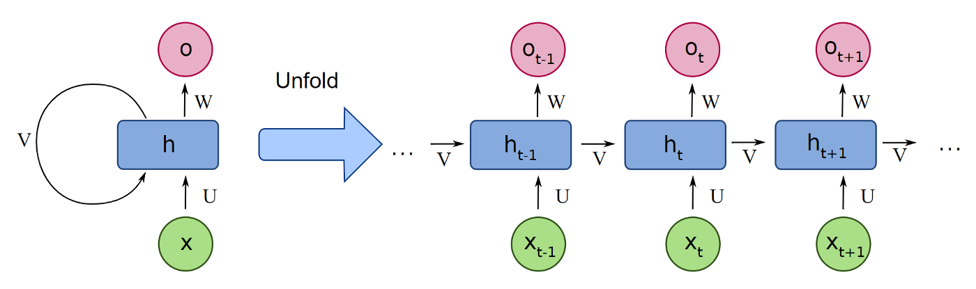
Recurrent Neural Networks
He said, “Teddy Roosevelt was a great President.”
He said, “Teddy bears are on sale!”

Slide 18
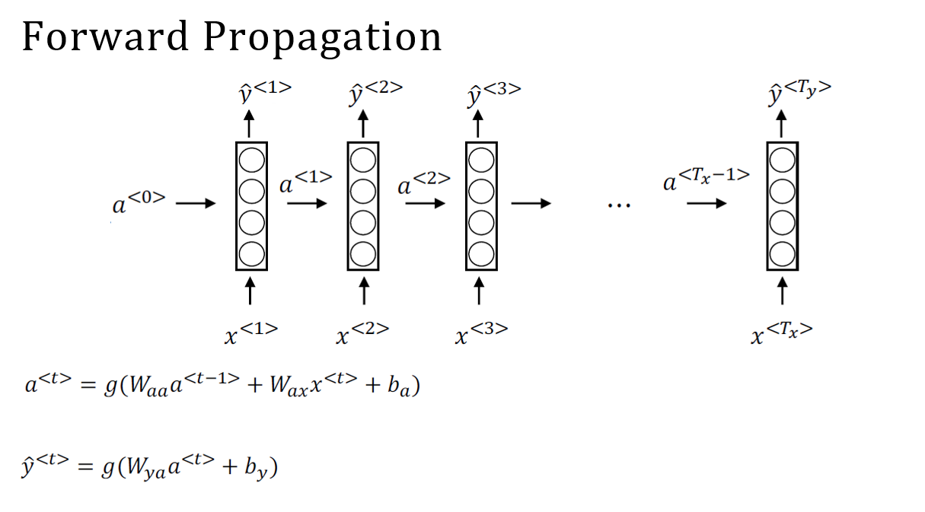

Slide 19
Recurrent Neural Networks
Backpropagation through time

Slide 20
Backpropagation through time
How does backpropagation work in a recurrent neural network (RNN)?
- The RNN has a basic structure where it takes an input sequence x^{<1>}, x^{<2>}, x^{<3>},..., x^{<Tx>} and computes activations a^{<0>} , a^{<1>}, a^{<2>}, a^{<3>},..., a^{<Tx-1>}. These activations are then used to compute predictions ŷ^{<1>}, ŷ^{<2>}, ŷ^{<3>},..., ŷ^{<Ty>}. The parameters used to compute activations and predictions are W_{a}, b_{a}, W_{y}, and b_{y}.

Slide 21
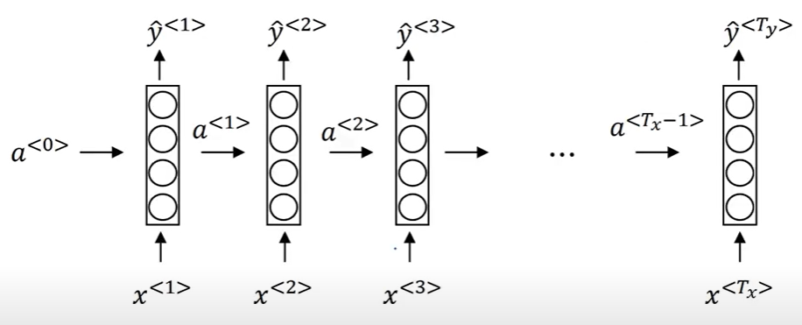
Backpropagation through time

Slide 22
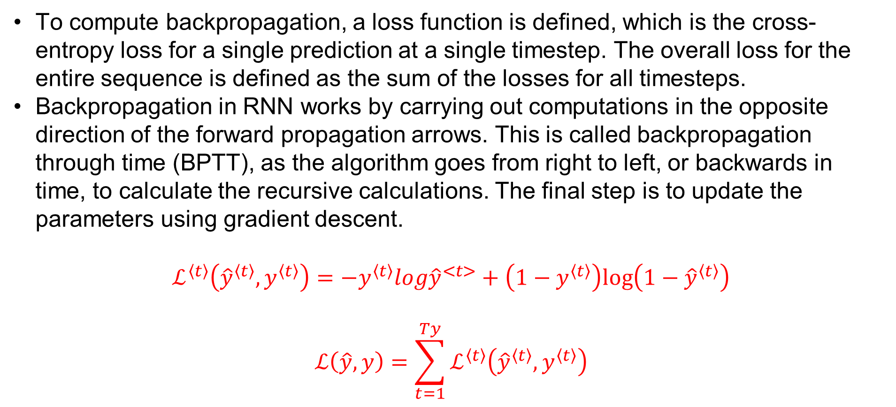
Backpropagation through time
To compute backpropagation, a loss function is defined, which is the cross-entropy loss for a single prediction at a single timestep. The overall loss for the entire sequence is defined as the sum of the losses for all timesteps.
Backpropagation in RNN works by carrying out computations in the opposite direction of the forward propagation arrows. This is called backpropagation through time (BPTT), as the algorithm goes from right to left, or backwards in time, to calculate the recursive calculations. The final step is to update the parameters using gradient descent.
$$ℒ^{\left\langle t\right\rangle }\left({\hat{y}}^{\left\langle t\right\rangle },y^{\left\langle t\right\rangle }\right)=−y^{\left\langle t\right\rangle }log{\hat{y}}^{<t>}+\left(1−y^{\left\langle t\right\rangle }\right)log\left(1−{\hat{y}}^{\left\langle t\right\rangle }\right)$$
$$ℒ\left(\hat{y},y\right)=\sum_{t=1}^{Ty}{ℒ^{\left\langle t\right\rangle }\left({\hat{y}}^{\left\langle t\right\rangle },y^{\left\langle t\right\rangle }\right)}$$

Slide 23
Backpropagation through time
Forward Pass:
Input Sequence: At each time step t, the RNN receives an input x_{t}​ and the hidden state h_{t-1}​ from the previous time step.
Hidden State Update: The RNN computes a new hidden state h_{t-1}​ based on the ​input x_{t} and the previous hidden state h_{t-1}​.
Output: The RNN produces an output y_{t} based on the current hidden state h_{t}​.
Backward Pass:
Loss Calculation: The output y_{t}​ is compared to the target output, and a loss is calculated using a loss function (e.g., mean squared error or cross-entropy).
Gradient Calculation: Gradients of the loss with respect to the parameters (weights and biases) are calculated using backpropagation. This involves calculating the gradients at each time step.
Weight Update: The model parameters are updated using an optimization algorithm (e.g., stochastic gradient descent) to minimize the loss.
Backpropagation Through Time:
Unrolling: BPTT involves unrolling the network through time, treating the sequence as a series of connected neural networks. This creates a computational graph where each time step corresponds to a layer.
Gradient Propagation: Gradients are propagated backward through the unrolled network, updating the parameters at each time step. The gradients are accumulated across time steps.
Truncation: To manage the exploding or vanishing gradient problem, the sequence is often truncated after a certain number of time steps. This helps in stabilizing the training process.
Parameter Update:
After completing the backward pass through the unrolled sequence, the accumulated gradients are used to update the model parameters in the optimization step.

Slide 24
Backpropagation through time
It's important to note that BPTT requires maintaining hidden states for each time step during the forward pass, which allows the model to capture information from the entire sequence.
However, this also makes BPTT computationally expensive and can lead to issues like vanishing or exploding gradients, which may require additional techniques such as gradient clipping or using more advanced RNN architectures (e.g., LSTM or GRU) to address.

Slide 25
Recurrent Neural Networks
Different types of RNNs

Slide 26
Different types of RNNs
Various RNN architectures serve specific purposes: one-to-one, one-to-many (e.g., music generation), many-to-one (e.g., sentiment classification), and many-to-many (e.g., machine translation with varying sequence lengths).
RNNs' basic blocks enable diverse model creation, with sequence generation subtleties discussed later.
Notes:
Consider examples of various RNN architectures, including one-to-one, one-to-many, many-to-one, and many-to-many, and describes their specific applications.
The one-to-many architecture can be used for music generation, where the input x could be an integer representing the genre of music or the first note of the piece, and the output would be a sequence of notes.
The many-to-one architecture can be used for sentiment classification, where the input is a piece of text, and the output is a single number representing the sentiment of the text, such as a rating from 1 to 5.
An interesting example of a many-to-many architecture for machine translation, where the input and output sequences can have different lengths. The architecture consists of an encoder that reads the input sequence, such as a French sentence, and a decoder that outputs the translated sentence in a different language, such as English.
The basic building blocks of an RNN can be used to create a wide range of models, and that there are some subtleties to sequence generation, which will be discussed in the next section.

Slide 27
Examples of sequence data
“The quick brown fox jumped over the lazy dog.”
Speech recognition
Music generation
∅
“There is nothing to like in this movie.”
Sentiment classification
DNA sequence analysis
AGCCCCTGTGAGGAACTAG
AGCCCCTGTGAGGAACTAG
Machine translation
Voulez-vous chanter avec moi?
Do you want to sing with me?
Video activity recognition
Running
Name entity recognition
Yesterday, Harry Potter met Hermione Granger.
Yesterday, Harry Potter met Hermione Granger.

Slide 28
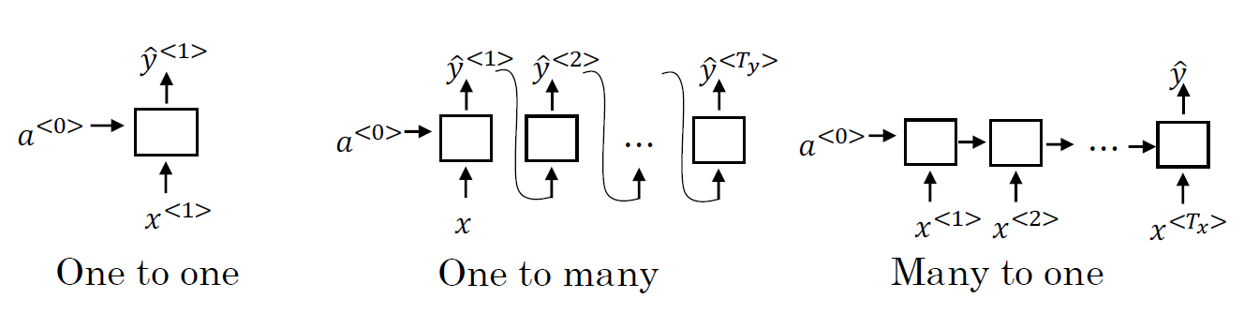
Examples of RNN architectures

Slide 29
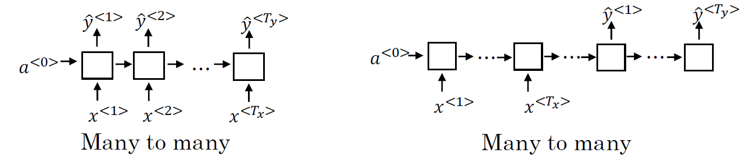
Examples of RNN architectures

Slide 30
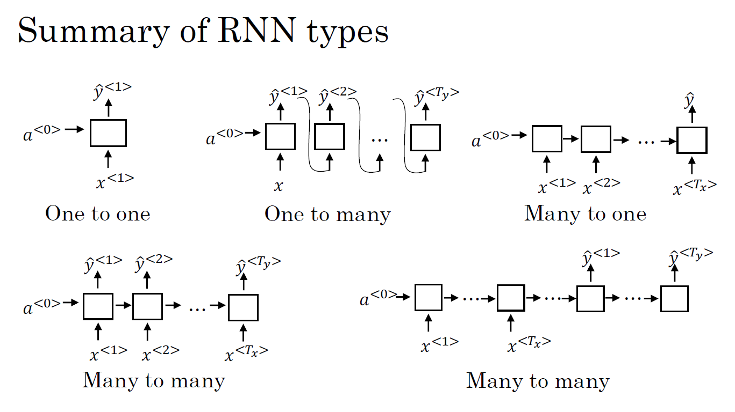

Slide 31
Recurrent Neural Networks
Language model and sequence generation

Slide 32
Language model and sequence generation
Language modeling predicts word sequence probabilities and is vital in tasks like speech recognition and machine translation. RNNs excel in building language models by capturing the sequential nature of language.
Training involves tokenizing a text corpus, mapping words to vectors or indices.
The RNN predicts the next word, learning sequentially from left to right. A cost function measures the difference during training.
The trained model can generate new text by sampling the most probable next word at each step. This allows the model to produce text resembling the training set or generate creative content.
Notes:
Language modeling is a crucial task in natural language processing that involves predicting the probability of a given sequence of words. Language models are used in many applications such as speech recognition and machine translation. An RNN is an excellent tool for building a language model because it can model the sequential nature of language.
To build a language model using an RNN, you first need a training set, which is typically a large corpus of text. The text is tokenized, meaning that each word is mapped to a one-hot vector or an index in a vocabulary. An extra token called EOS may be added to indicate the end of a sentence.
The RNN model takes in a sequence of tokens and outputs a probability distribution over the next word in the sequence. The RNN learns to predict one word at a time going from left to right. To train the model, a cost function is defined, which measures the difference between the predicted probability distribution and the true distribution.
Once the language model is trained, it can be used to generate new text. Sampling from the model involves selecting the most probable next word at each step and using it as input for the next step. The model can be used to generate text similar to the training set, or to generate creative new text.

Slide 33
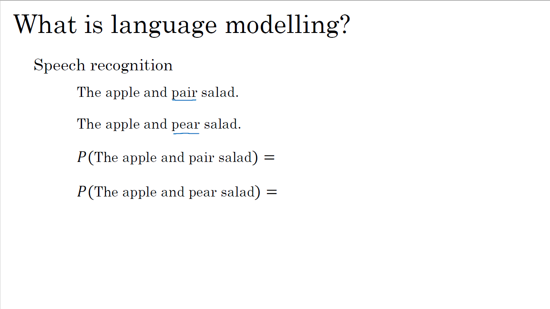

Slide 34
Language modelling with an RNN
Training set: large corpus of english text.
Cats average 15 hours of sleep a day.
The Egyptian Mau is a bread of cat. <EOS>

Slide 35
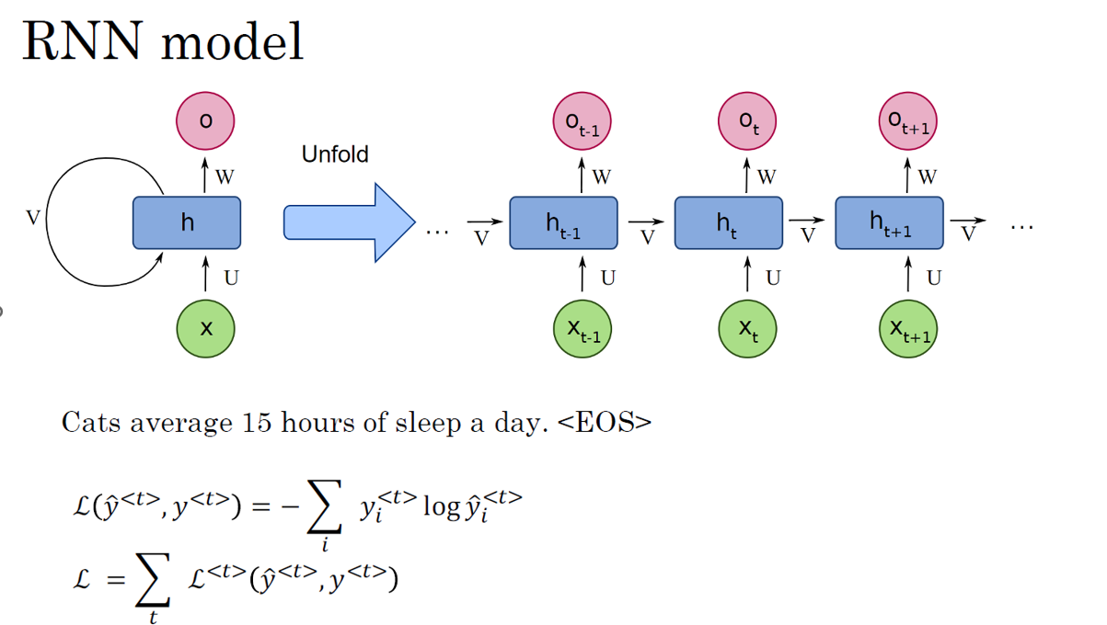

Slide 36
Recurrent Neural Networks
Sampling novel sequences

Slide 37
Sampling novel sequences
After training, sequence models reveal learning by generating novel sequences through sampling predictions. This involves sampling the first word, passing it to subsequent steps, and repeating until sequence completion.
Word-level models use word vocabularies, while character-level models use individual characters, avoiding unknown word tokens. However, they handle longer sequences and are computationally intensive.
Powerful models like GRUs and LSTMs address training challenges, overcoming issues like vanishing gradients.
Notes:
To get a sense of what a sequence model has learned after training, one can generate novel sequences by sampling from the distribution of the model's predictions. The process of generating novel sequences involves sampling the first word from the softmax distribution output of the first time step, passing the sampled word as input to the next time step, and repeating the process until the end of the sequence is reached (either by sampling an end-of-sentence token or reaching a specified number of time steps).
For a word-level language model, the vocabulary consists of words, while for a character-level language model, the vocabulary consists of individual characters.
The advantage of character-level models is that they do not have to deal with unknown word tokens, but the disadvantage is that they tend to have longer sequences and are more computationally expensive to train.
To deal with the challenges of training RNNs, more powerful models such as the Gated Recurrent Unit (GRU) and Long Short-Term Memory (LSTM) models have been developed. These models help to address the problem of vanishing gradients, which can occur when the gradients that are propagated through the network become very small and make it difficult to update the weights properly.

Slide 38
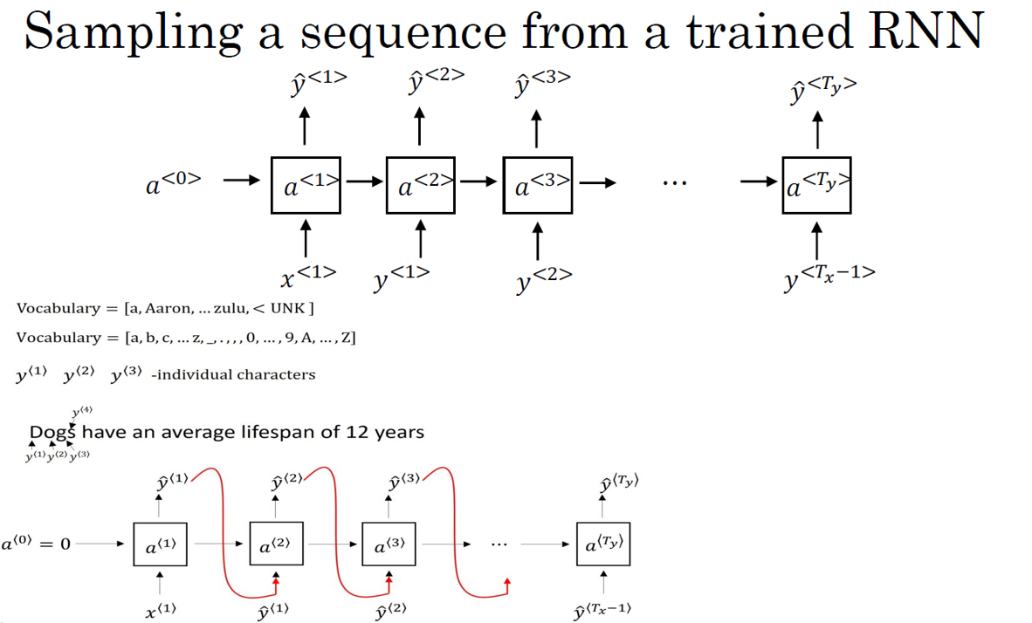

Slide 39
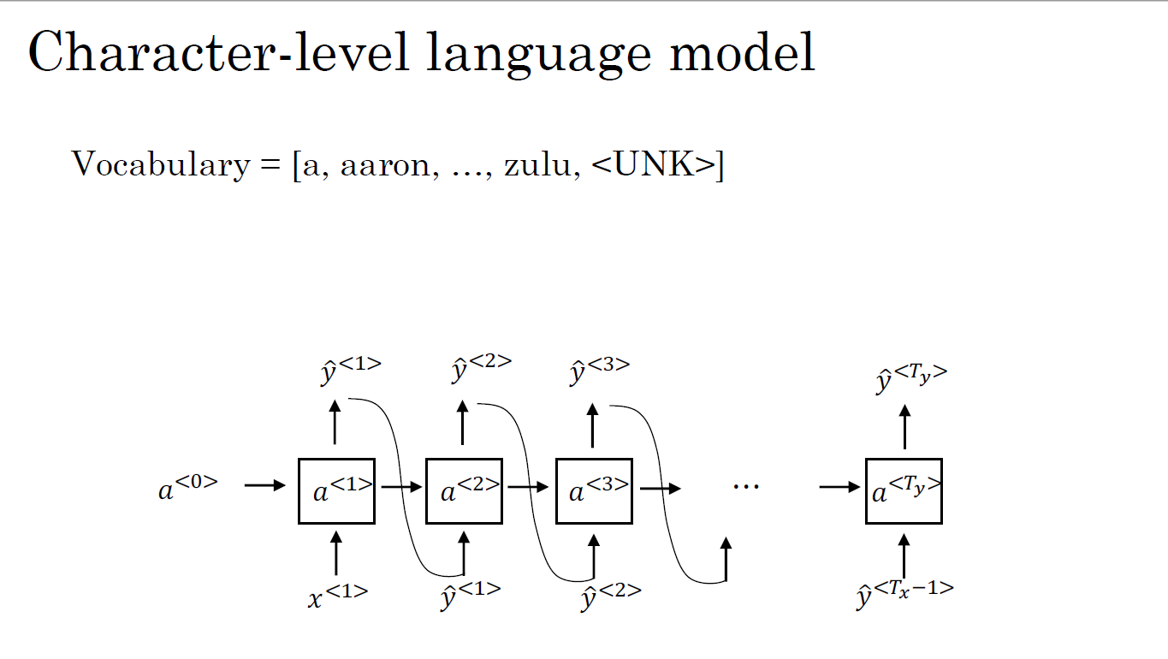

Slide 40
Sequence generation
News
Shakespeare
President enrique peña nieto, announced sench’s sulk former coming football langston paring.
“I was not at all surprised,” said hich langston. “Concussion epidemic”, to be examined.
The gray football the told some and this has on the uefa icon, should money as.
The mortal moon hath her eclipse in love.
And subject of this thou art another this fold. When besser be my love to me see sabl’s.
For whose are ruse of mine eyes heaves.

Slide 41
Recurrent Neural Networks
Vanishing gradients with RNNs

Slide 42
Vanishing gradients with RNNs
In deep neural network training, the vanishing gradient problem hinders backward propagation, especially in RNNs where forward propagation is left to right and backpropagation is right to left.
This challenge makes it hard for errors in later time steps to influence earlier computations, limiting the model's ability to capture long-range dependencies.
In very deep networks, exploding gradients can occur, but vanishing gradients pose a more significant issue in RNN training.
While exploding gradients are noticeable, vanishing gradients are harder to solve.
Advanced RNN models like GRUs and LSTMs address the vanishing gradient problem, enabling the capture of longer-range dependencies.
Notes:
When training deep neural networks, the gradient from the output has a hard time propagating back to affect the weights of the earlier layers, which is known as the vanishing gradient problem. In the case of an RNN, the forward propagation goes from left to right, and the backpropagation goes from right to left. It can be difficult for the errors associated with the later time steps to affect the computations of the earlier ones due to the same vanishing gradient problem.
In the case of the RNN, the problem of vanishing gradients means that the model has many local influences, and it's difficult for the output to be strongly influenced by an input that was very early in the sequence. This is a weakness of the basic RNN algorithm that can make it challenging for the model to capture long-range dependencies.
Although when discussing very deep neural networks, the problem of exploding gradients can also happen, vanishing gradients are the biggest problem with training RNNs. Exploding gradients are easier to spot because the parameters just blow up, and you might often see NaNs as a result of numerical overflow in your neural network computation.
If exploding gradients occur, one solution is to apply gradient clipping, which involves re-scaling the gradient vectors if they are bigger than some threshold. However, vanishing gradients are much harder to solve and will be the subject of the next few sections.
To address the vanishing gradient problem, more advanced RNN models such as GRUs and LSTMs have been developed. These models allow the neural network to capture longer-range dependencies and solve the problem of vanishing gradients.

Slide 43
Recurrent Neural Networks
Gated Recurrent Unit (GRU)

Slide 44
Gated Recurrent Unit (GRU)
The Gated Recurrent Unit (GRU) enhances the standard Recurrent Neural Network (RNN) hidden layer to address vanishing gradient problems and capture long-range connections.
It introduces a memory cell (C) to retain essential information from previous timesteps. A gate, ranging from 0 to 1, decides whether to update the memory cell. The update gate determines when to update, and the relevance gate gauges the importance of the previous memory cell. The memory cell's actual value is computed using the gates and candidate new and old values.
GRUs and LSTMs, both derived from these concepts, are widely used in neural network design for their effectiveness.
Notes:
The Gated Recurrent Unit (GRU) is a modification to the standard Recurrent Neural Network (RNN) hidden layer that helps capture long-range connections and address vanishing gradient problems. The GRU has a new variable called C, which stands for cell or memory cell that provides some memory to help the network remember important details from previous timesteps. The GRU has a gate, which is a value between 0 and 1, that decides whether or not to update the memory cell at each timestep. The update gate determines when to update the memory cell, while the relevance gate determines how relevant the previous memory cell is to computing the next candidate for the memory cell. The actual value of the memory cell is computed as the gate times the candidate new value plus one minus the gate times the old value.
There are multiple ways to design these types of neural networks, and GRUs and LSTMs are two specific instantiations of these ideas that are commonly used.

Slide 45
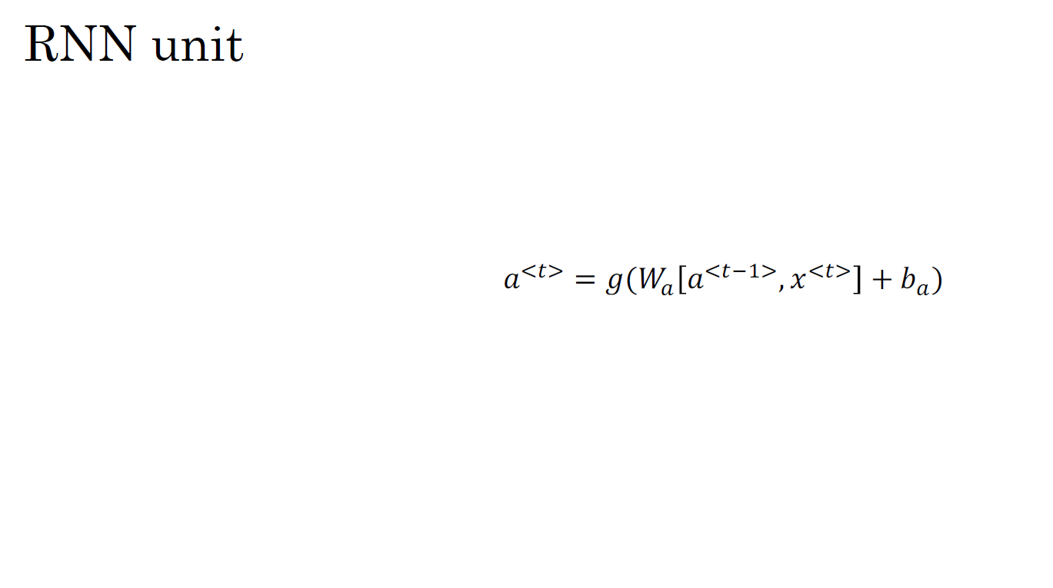
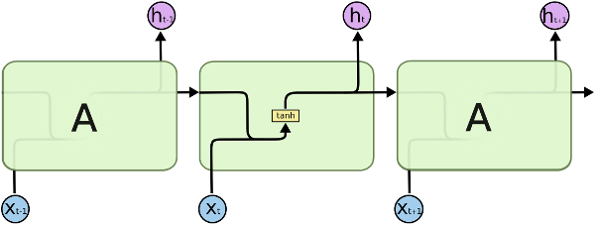



RNN unit
!"#$ _{= &(() !}"#*+$_{, -}"#$
+ /₎)

Slide 46
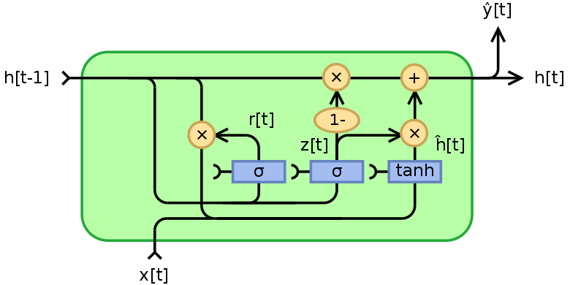
GRU (simplified)
The cat, which already ate …, was full.

Slide 47
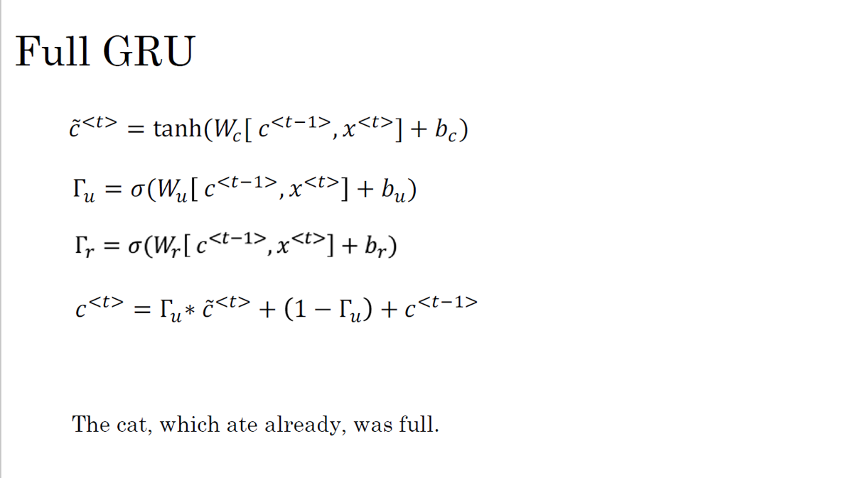

Slide 48
Recurrent Neural Networks
LSTM (long short term memory) unit

Slide 49
LSTM (long short term memory) unit
The Long Short-Term Memory (LSTM) unit is another type of recurrent neural network (RNN) that allows for learning long-range dependencies in a sequence. Compared to the Gated Recurrent Unit (GRU), the LSTM is even more powerful and flexible due to its three gates: an input gate, an output gate, and a forget gate.
Input Gate: The input gate determines which values from the current input and the previous hidden state should be updated and added to the cell state.
Forget Gate: The forget gate determines which information from the cell state should be discarded or kept for the current time step.
Output Gate: The output gate determines the next hidden state and the output of the LSTM cell.
Notes:
The Long Short-Term Memory (LSTM) unit is another type of recurrent neural network (RNN) that allows for learning long-range dependencies in a sequence. Compared to the Gated Recurrent Unit (GRU), the LSTM is even more powerful and flexible due to its three gates: an input gate, an output gate, and a forget gate.
The equations governing the LSTM are more complex than those for the GRU, but they can be visualized using a diagram. In an LSTM network, the input and previous hidden state are combined to compute the forget, input, and output gates, which control the flow of information in and out of the memory cell. The candidate value for updating the memory cell is then computed based on the input and previous hidden state, and the memory cell is updated using the forget and input gates. Finally, the output gate is used to compute the output based on the current memory cell value.

Slide 50
LSTM (long short term memory) unit
There are also variations on the LSTM, such as the peephole connection, which allows the gate values to depend on the previous memory cell value in addition to the input and previous hidden state.
Both the GRU and LSTM have been tried on many different problems, and the choice between them depends on the specific problem and the trade-off between simplicity and power.
The GRU is simpler and faster, making it easier to build bigger models, while the LSTM is more powerful and flexible. However, the LSTM has been the historically more proven choice and is often used as the default first thing to try.

Slide 51
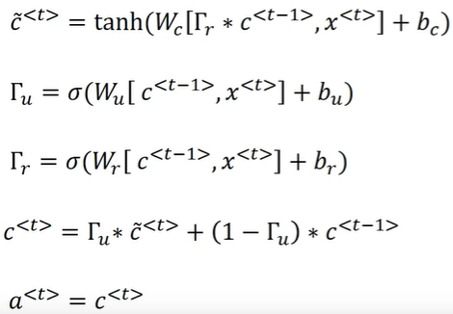
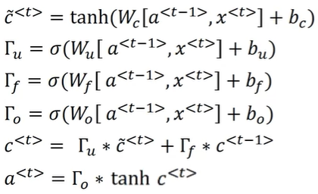
GRU and LSTM
GRU LSTM

Slide 52
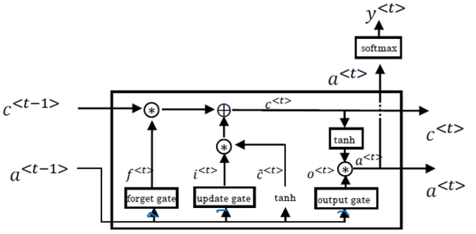
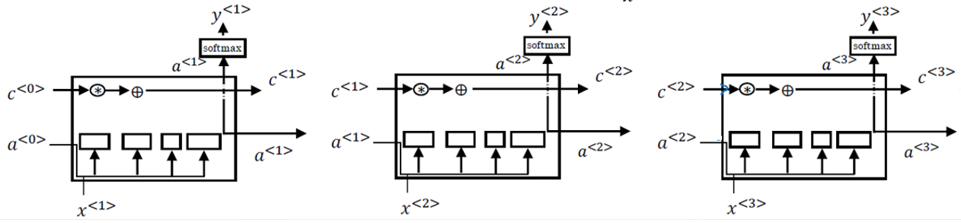
LSTM in pictures

Slide 53
Recurrent Neural Networks
Bidirectional RNN

Slide 54
Bidirectional RNN
A bidirectional RNN (BRNN) enhances the basic RNN, GRU, or LSTM by considering information from both the past and future at any given time, beneficial for tasks like named entity recognition or speech recognition.
Constructed with two separate RNNs processing the sequence in opposite directions, their outputs are concatenated for predictions.
While limited by requiring the entire sequence for predictions, it excels in tasks with full sentence data.
Deep bidirectional RNNs (DBRNNs), featuring multiple stacked BRNN layers, further improve by capturing intricate patterns and dependencies for enhanced performance in various NLP tasks.
Notes:
A bidirectional RNN (BRNN) is a modification of the basic RNN architecture, as well as the GRU or LSTM. It allows the model to take into account information from both the past and the future at any given point in time, which can be useful in tasks such as named entity recognition or speech recognition.
To construct a BRNN, the basic idea is to have two separate RNNs - one that processes the input sequence from left to right, and another that processes the input sequence from right to left. Each RNN has its own set of weights and hidden states. The outputs of both RNNs are then concatenated at each time step and used to make predictions.
One of the limitations of the BRNN is that it requires the entire sequence of data before making predictions anywhere. This means that in real-time speech recognition applications, more complex models are needed rather than just using the standard BRNN. However, for many natural language processing tasks where the entire sentence is available, the BRNN is a very effective model.
To make the BRNN even more powerful, we can add more layers to the model and create a deep bidirectional RNN (DBRNN). A DBRNN is a neural network that has multiple layers of BRNNs stacked on top of each other. Each layer takes the output of the previous layer as input. This allows the model to capture more complex patterns and dependencies in the input sequence, which can lead to better performance on many NLP tasks.
In summary, the BRNN is a modification of the basic RNN architecture that allows the model to take into account information from both the past and the future at any given point in time. The DBRNN is a more powerful version of the BRNN that can capture more complex patterns and dependencies in the input sequence.

Slide 55
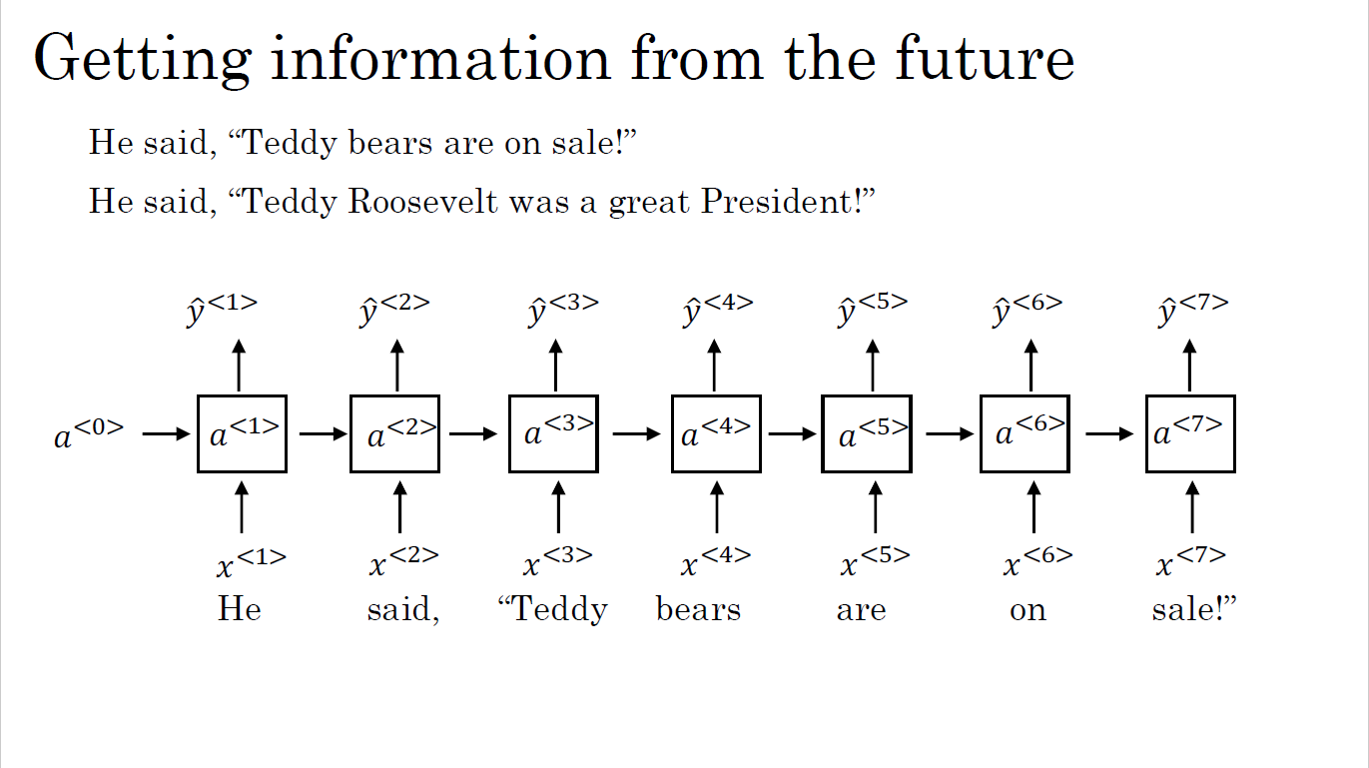

Slide 56
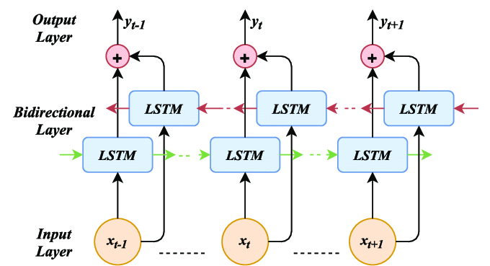
Bidirectional RNN (BRNN)

Slide 57
Recurrent Neural Networks
Deep RNNs

Slide 58
Deep RNNs
In a deep RNN, each layer has its own activation value over time, computed using inputs from the previous layer and the previous time step.
Despite the potential for large networks with even a few layers, having three layers is substantial for RNNs. Deep RNNs can utilize GRU and LSTM blocks, and deep bidirectional RNNs are feasible.
Due to computational costs, deep RNNs with extensive temporal dimensions are less common. Typically, deep recurrent layers are stacked, followed by a deep network for output prediction.
In summary, leveraging various RNN types allows the construction of potent sequence models.
Notes:
This section explain how to build deeper versions of RNNs by stacking multiple layers of RNNs together.
Consider a standard neural network with an input X, a hidden layer, and a prediction ŷ. A deep RNN is similar, but instead of a single hidden layer, it has multiple hidden layers stacked on top of each other, and each layer has its own activation value associated with it over time. An example of how to compute the activation value for a layer at a particular time step using the input from the previous layer and the input from the previous time step.
Due to the temporal dimension, even just a small handful of layers can make the network quite large, and having three layers is already quite a lot for RNNs. Additionally, deep RNNs can also be built using GRU and LSTM blocks and that deep versions of bidirectional RNNs can also be constructed.
Due to their computational expense, deep RNNs with a large temporal extent are not commonly used, and instead, it is more common to have deep recurrent layers stacked on top of each other, followed by a deep network that predicts the output.
Overall, with the toolbox of RNNs, including basic RNNs, GRUs, LSTMs, bidirectional RNNs, and deep versions of these models, one can construct very powerful models for learning sequence models.

Slide 59
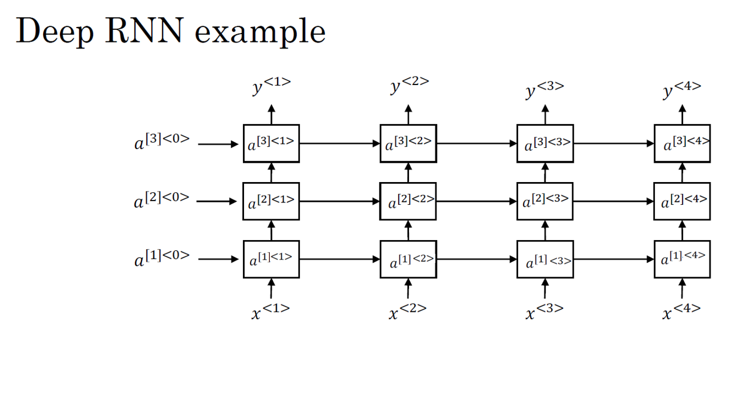

Slide 60
Summarization
Sequence models, crucial for tasks like NLP and time series analysis, process sequential data.
Basic Recurrent Neural Networks (RNNs) maintain hidden states to capture information across time steps.
Backpropagation Through Time trains RNNs by unfolding them through time.
RNN variations include one-to-one, one-to-many, many-to-one, and many-to-many architectures for diverse tasks.
Language models predict the next word, enabling text generation.
GRU mitigates vanishing gradients in RNNs using gating mechanisms.
LSTM incorporates memory cells to capture long-term dependencies.
Bidirectional RNNs process sequences in both directions.
Deep RNNs stack multiple layers for intricate pattern learning.
Notes:
Why Sequence Models:
Sequence models are essential for tasks involving sequential data, such as natural language processing, speech recognition, and time series analysis, where the order of data points matters.
Notation:
Introduces the notation commonly used in sequence models, including input sequences x, output sequences y, and time steps t.
Recurrent Neural Network Model:
Describes the basic structure of Recurrent Neural Networks (RNNs), which maintain hidden states to capture information from previous time steps, allowing them to process sequential data.
Backpropagation Through Time:
Explains the technique of backpropagation through time, used to train RNNs by unfolding them through time and applying backpropagation to compute gradients.
Different Types of RNNs:
Discusses variations of RNNs, including one-to-one, one-to-many, many-to-one, and many-to-many architectures, adapting RNNs for various tasks
Language Model and Sequence Generation:
Language models use sequences of words to predict the likelihood of the next word, enabling tasks like text generation and machine translation.
Sampling Novel Sequences:
Describes how language models can be used to sample and generate new, coherent sequences of text, enabling creative applications like chatbots and storytelling.
Vanishing Gradients with RNNs:
Addresses the vanishing gradient problem in RNNs, where gradients diminish as they propagate back in time, hindering the learning of long-term dependencies.
Gated Recurrent Unit (GRU):
Introduces the GRU, a variant of RNNs designed to mitigate the vanishing gradient problem by using gating mechanisms to regulate the flow of information.
LSTM (Long Short-Term Memory) Unit:
Describes LSTM units, which are another type of RNN designed to capture long-term dependencies by incorporating memory cells and various gates to control information flow.
Bidirectional RNN:
Explains Bidirectional RNNs, which process sequences in both forward and backward directions, enhancing the model's understanding of context from both past and future inputs.
Deep RNNs:
Discusses the concept of stacking multiple layers of RNNs to create deep architectures, allowing the model to learn intricate patterns and representations in sequential data.

